Slide 1

Image to Image
Translation
THE ORIGINAL IS UNFAITHFUL TO THE TRANSLATION.

Slide 2
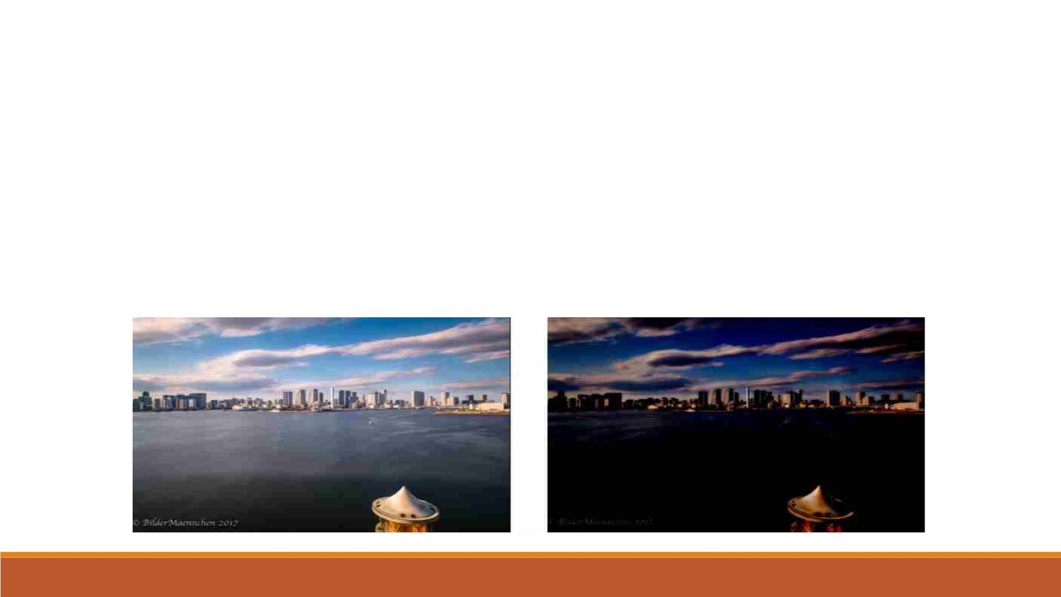
What is Image to Image Translation?
§ Image-to-Image Translation is a task in computer vision and machine learning where the goal is to
learn a mapping between an input image and an output image, such that the output image can be used
to perform a specific task, such as style transfer, data augmentation, or image restoration.
§ It is a class of vision and graphics problems where the goal is to learn the mapping between an input
image and an output image. It can be applied to a wide range of applications, such as collection style
transfer, object transfiguration, season transfer and photo enhancement.

Slide 3
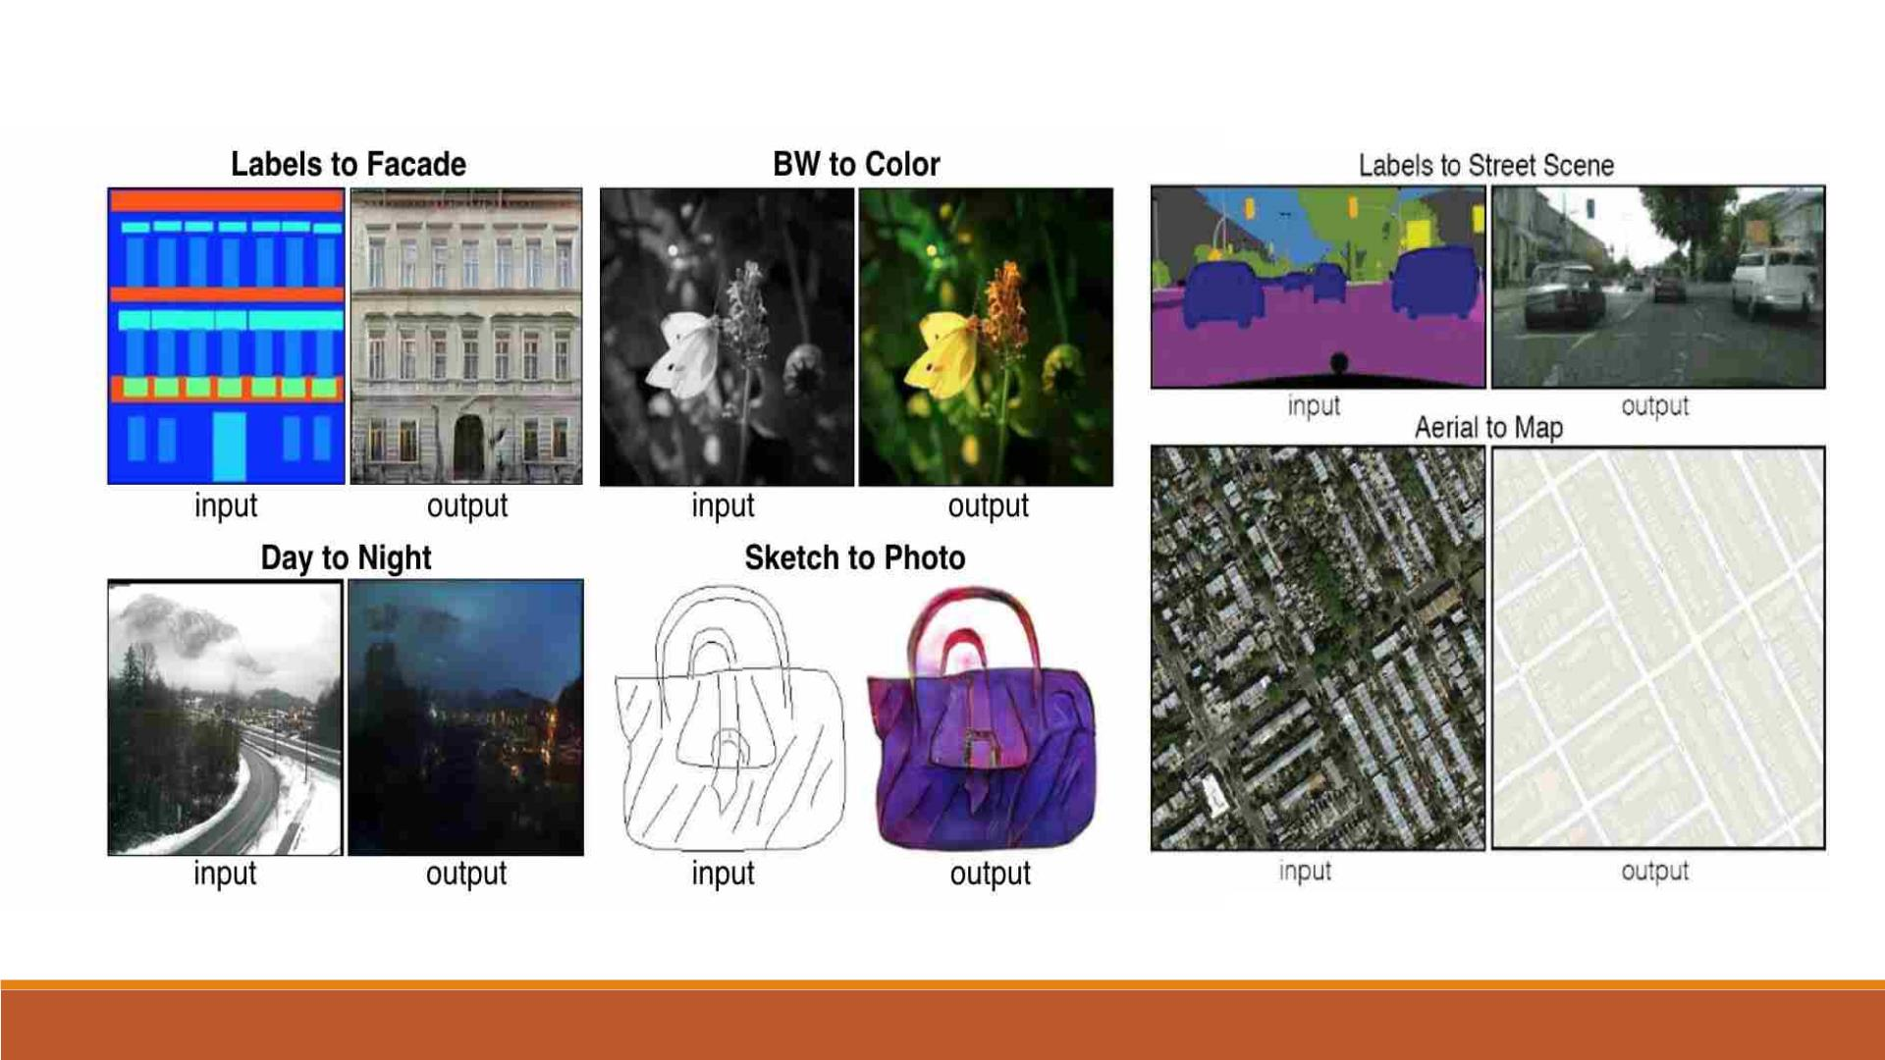
Different tasks in image translation

Slide 4
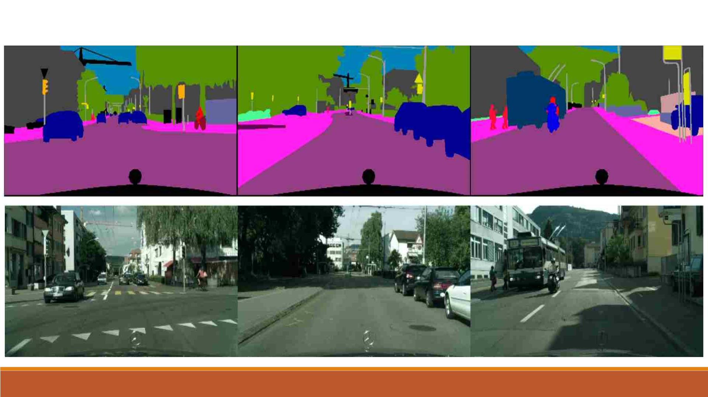
Our Project: drawing to street scene translation

Slide 5
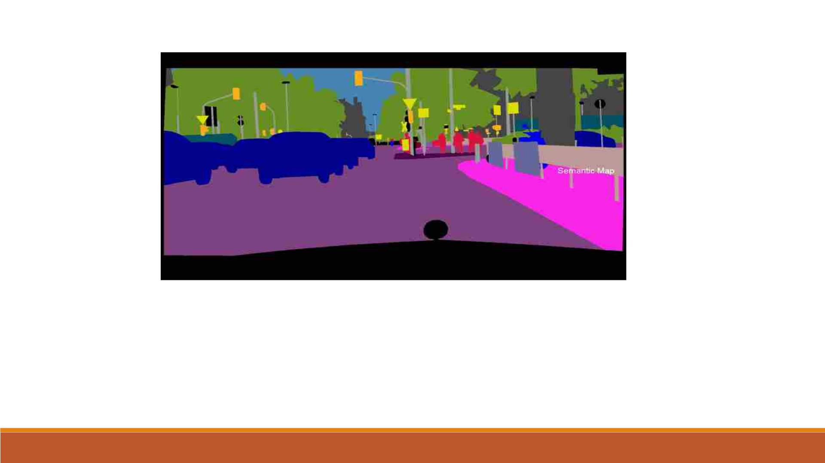
Streetscape drawing to street scene translation
§ This street scape is an artistic representation, such as painting, drawing, print or photograph, of the physical aspects
of a city or urban area.
§ We need to translate these street scape drawing into real street scene using various deep learning and machine
learning techniques.
§ This data is obtained from cityscapes dataset is intended for assessing the performance of vision algorithms for major
tasks of semantic urban scene understanding.

Slide 6

Libraries Used
q Tensor Flow
• TensorFlow is an opensource framework developed by Google researchers to run machine
learning, deep learning and other statistical and predictive analytics workloads.
• It's designed to streamline the process of developing and executing advanced analytics
applications.
• TensorFlow applications can run on either conventional CPUs or higher-performance
graphics processing units (GPUs), as well as Google's own tensor processing units (TPUs)

Slide 7

Libraries Used
q Keras
• Keras is an open-source high-level Neural Network library, which is written in Python is
capable enough to run on Theano, TensorFlow, or CNTK.
• It is made user-friendly, extensible, and modular for facilitating faster experimentation with
deep neural networks.
• It not only supports Convolutional Networks and Recurrent Networks individually but also
their combination.

Slide 8

Libraries Used
q Matplotlib
• Matplotlib is a comprehensive library for creating static, animated, and interactive
visualizations in python.
• Matplotlib relies on the Pillow library to load image data. It's a 24-bit RGB PNG. Depending
on where you get your data, the other kinds of image that you'll most likely encounter are
RGBA images, which allow for transparency, or single-channel grayscale (luminosity) images.
• It is used to generate graphs on model performance and used for showing images.

Slide 9
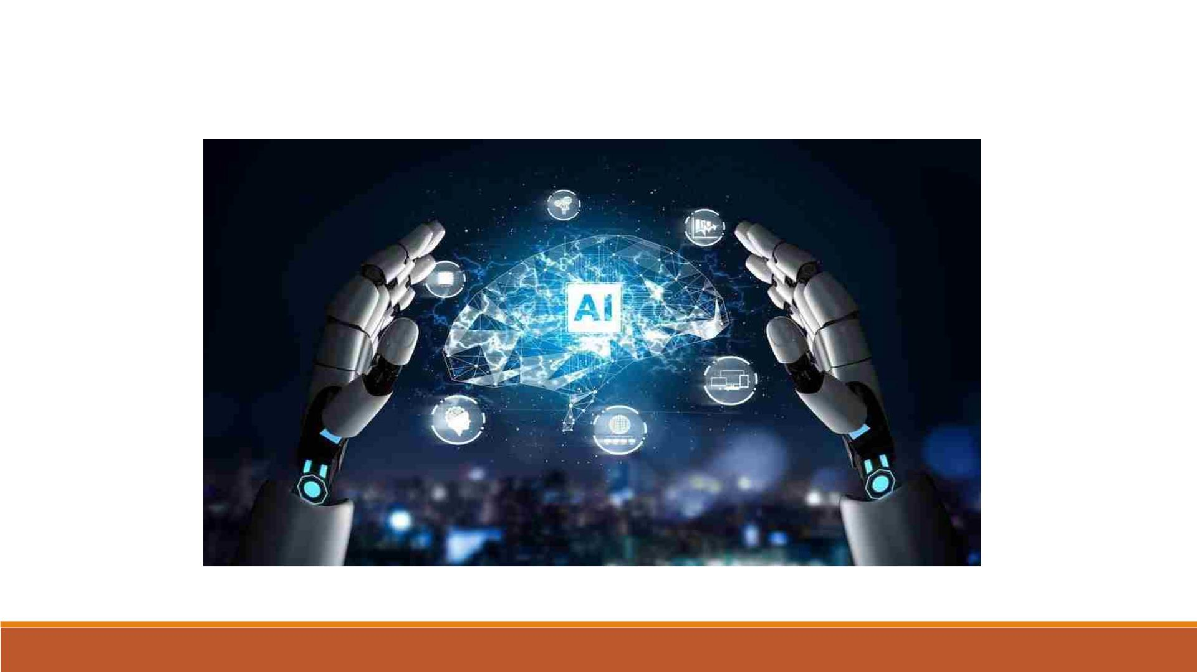
Generative adversarial network (GAN)

Slide 10

Generative adversarial network (GAN)
§ A generative adversarial network (GAN) is a class of machine learning frameworks and a
prominent framework for approaching generative AI
§ The concept was initially developed by Ian Goodfellow and his colleagues in June 2014
§ In a GAN, two neural networks contest with each other in the form of a zero-sum game, where
one agent's gain is another agent's loss.
§ Given a training set, this technique learns to generate new data with the same statistics as the
training set.
§ For example, a GAN trained on photographs can generate new photographs that look at least
superficially authentic to human observers, having many realistic characteristics. Though
originally proposed as a form of generative model for unsupervised learning, GANs have also
proved useful for semi-supervised learning, fully supervised learning, and reinforcement
learning

Slide 11
Generative adversarial network (GAN)
The original GAN is defined as the following :
• There are 2 players: generator and discriminator.
• The generator task is to match its own output distribution as closely as possible to the
reference distribution.
• The generator aims to minimize the objective, and the discriminator aims to maximize
the objective.
• The discriminator's task is to output a value close to 1 when the input appears to be
from the reference distribution, and to output a value close to 0 when the input looks like
it came from the generator distribution.

Slide 12
Generative adversarial network (GAN)
§ The generative network generates candidates while the discriminative network evaluates
them. The contest operates in terms of data distributions.
§ Typically, the generative network learns to map from a latent space to a data distribution of
interest, while the discriminative network distinguishes candidates produced by the
generator from the true data distribution.
§ The generative network's training objective is to increase the error rate of the
discriminative network (i.e., "fool" the discriminator network by producing novel
candidates that the discriminator thinks are not synthesized (are part of the true data
distribution)).

Slide 13
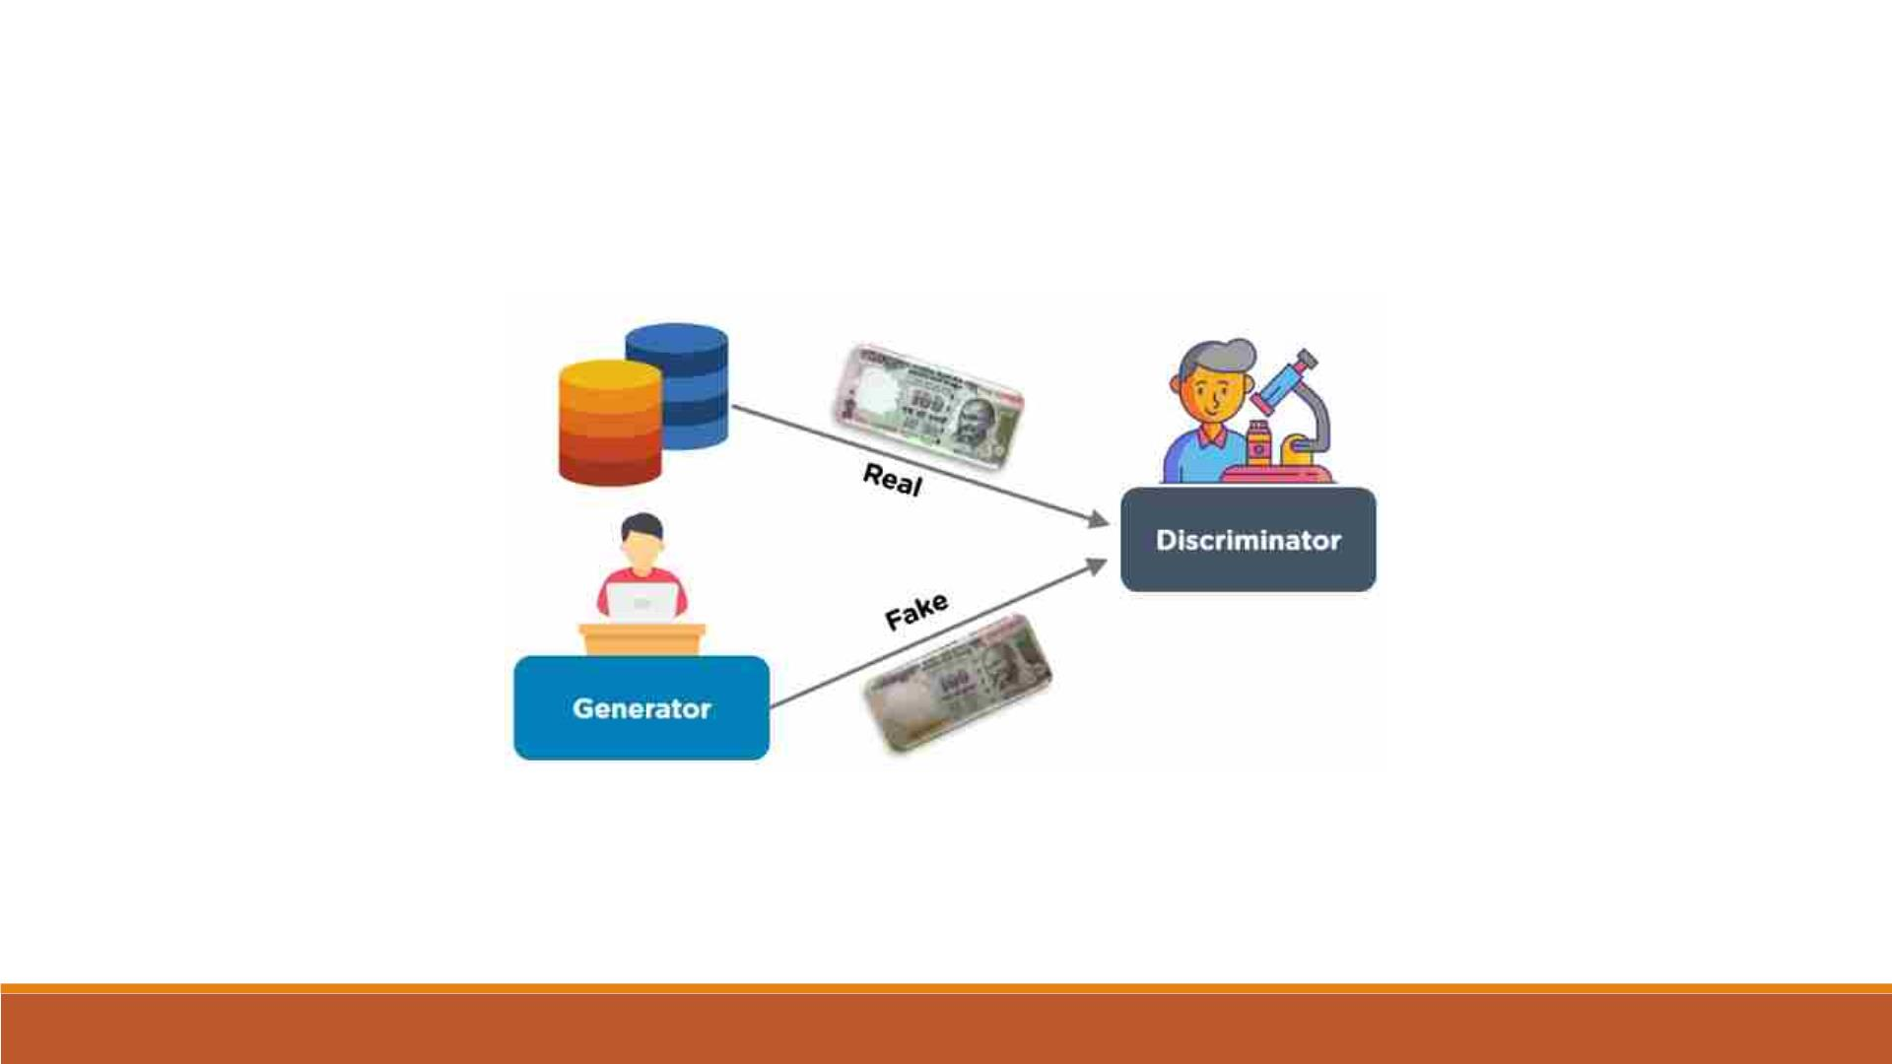
Generative adversarial network (GAN)

Slide 14
Generative adversarial network (GAN)
§ A known dataset serves as the initial training data for the discriminator. Training involves
presenting it with samples from the training dataset until it achieves acceptable accuracy.
The generator is trained based on whether it succeeds in fooling the discriminator.
§ Typically, the generator is seeded with randomized input that is sampled from a
predefined latent space (ex: a multivariate normal distribution). Thereafter, candidates
synthesized by the generator are evaluated by the discriminator.
§ Independent backpropagation procedures are applied to both networks so that the
generator produces better samples, while the discriminator becomes more skilled at
flagging synthetic samples.
§ When used for image generation, the generator is typically a deconvolutional neural
network, and the discriminator is a convolutional neural network.

Slide 15
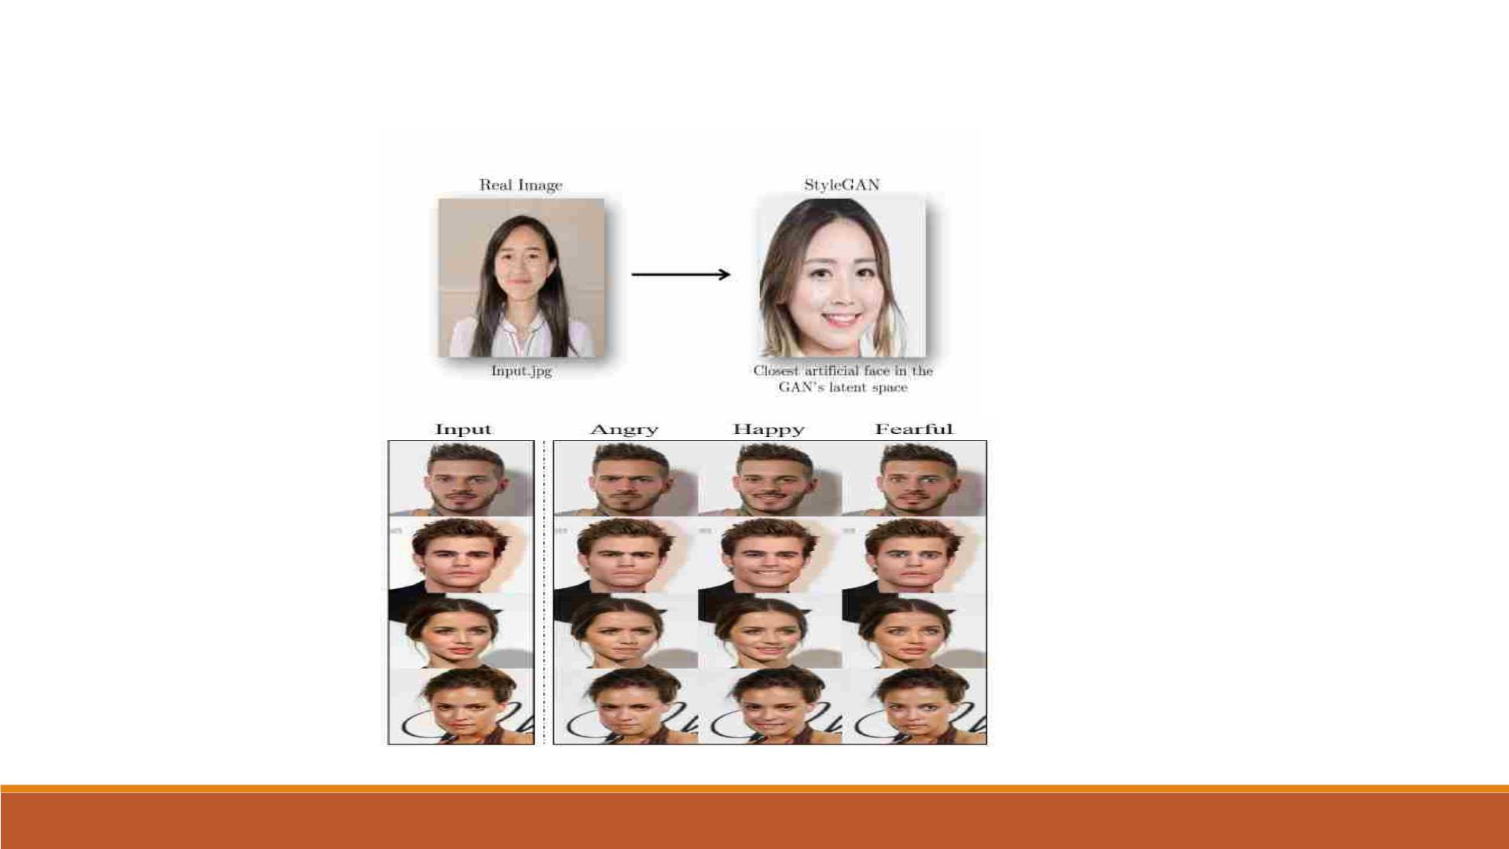
Different types of GANs
q StyleGAN
q StarGAN

Slide 16
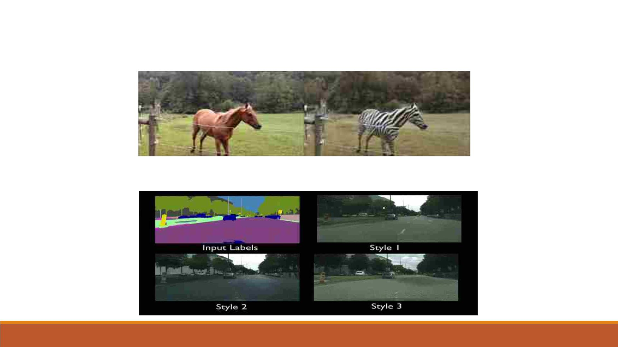
Different types of GANs
q Cyclic GAN
q Conditional GAN (CGAN)

Slide 17
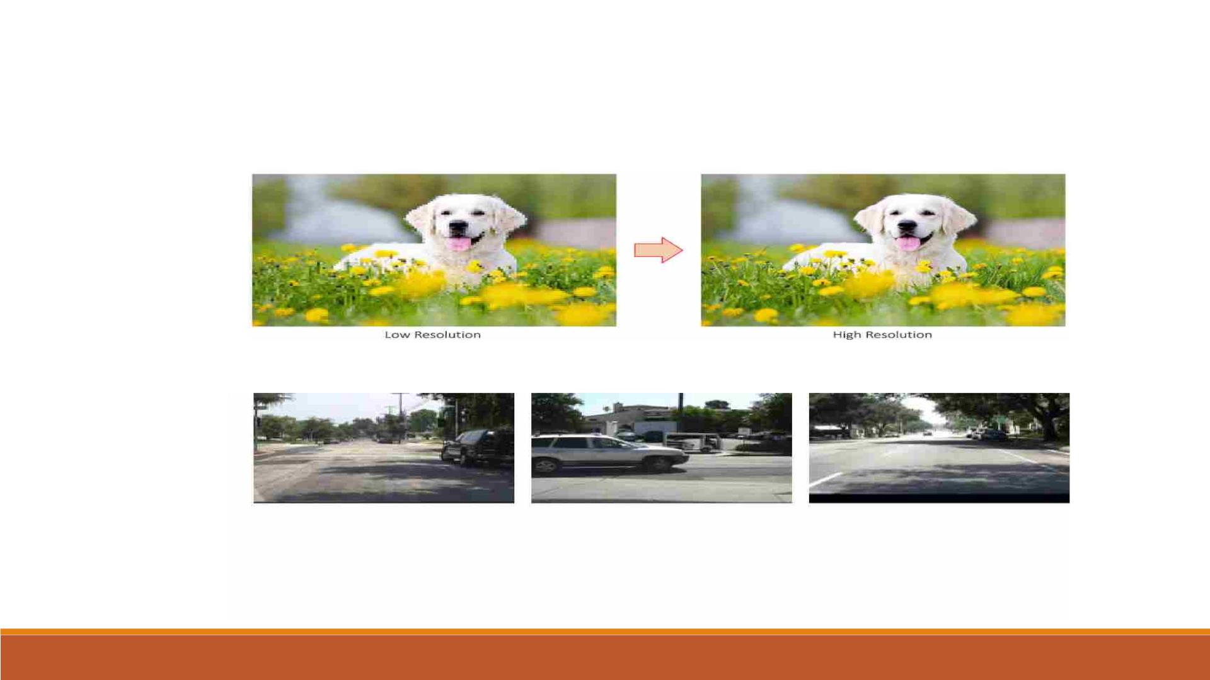
Different types of GANs
q Super Resolution (SRGAN)
q FutureGAN

Slide 18
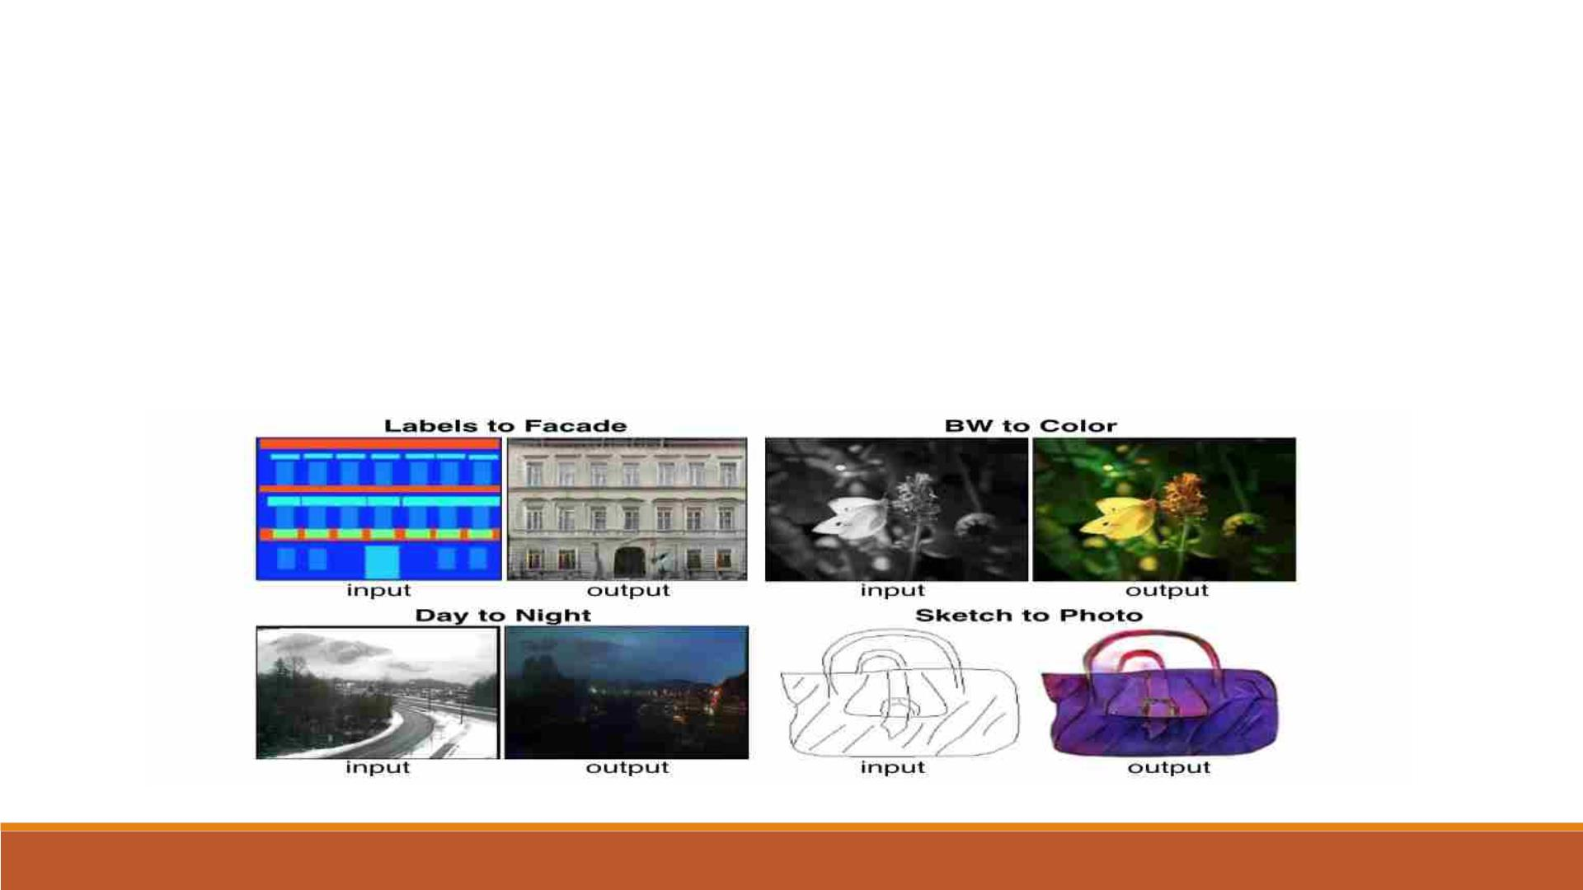
Pix2Pix: image translation with Conditional GAN
§ This Project is used to build and train a conditional generative adversarial network (cGAN) called
pix2pix that learns a mapping from input images to output images, as described in image-to-image
translation with conditional generative adversarial networks.
§ pix2pix is not application specific—it can be applied to a wide range of tasks, including synthesizing
photos from label maps, generating colorized photos from black and white images, turning Google
Maps photos into aerial images, and even transforming sketches into photos.

Slide 19
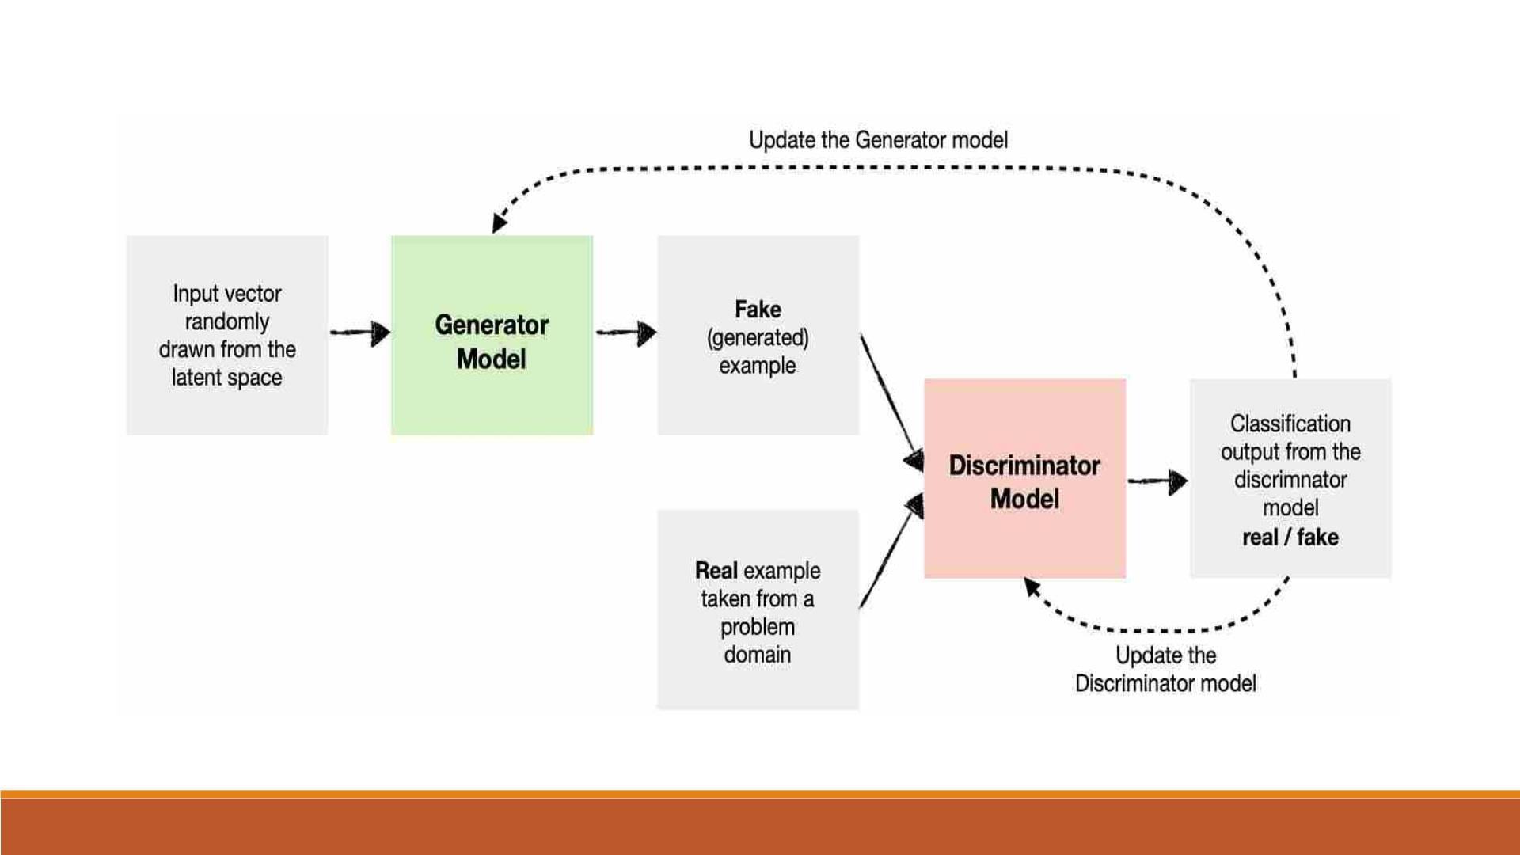
Pix2Pix: image translation with Conditional GAN

Slide 20
Pix2Pix: image translation with Conditional GAN
§ In the pix2pix cGAN, your condition on input images and generate corresponding output images.
§ The architecture of your network will contain:
• A generator with a U-Net-based architecture.
• A discriminator represented by a convolutional PatchGAN classifier (proposed in the pix2pix paper)
§ Note that each epoch can take around 15 seconds on a single V100 GPU.
§ As described in the pix2pix paper, you need to apply random jittering and mirroring to preprocess the
training set. Define several functions that
• Resize each 256 x 256 image to a larger height and width—286 x 286.
• Randomly crop it back to 256 x 256.
• Randomly flip the image horizontally i.e left to right (random mirroring).
• Normalize the images to the [-1, 1] range.

Slide 21
Pix2Pix: image translation with Conditional GAN
The Generator
§ The generator of your pix2pix cGAN is a modified U-Net. A U-Net consists of an encoder
(downsampler) and decoder (upsampler).
§ Each block in the encoder is: Convolution -> Batch normalization -> Leaky ReLU
§ Each block in the decoder is: Transposed convolution -> Batch normalization -> Dropout
(applied to the first 3 blocks) -> ReLU
§ There are skip connections between the encoder and decoder (as in the U-Net).

Slide 22
Pix2Pix: image translation with Conditional GAN
The Generator Loss
GANs learn a loss that adapts to the data, while cGANs learn a structured loss that penalizes a
possible structure that differs from the network output and the target image, as described in the
pix2pix paper
§ The generator loss is a sigmoid cross-entropy loss of the generated images and an array
of ones
§ The generator loss is a sigmoid cross-entropy loss of the generated images and an array of
ones
§ This allows the generated image to become structurally similar to the target image.
§ The formula to calculate the total generator loss is gan_loss + LAMBDA * l1_loss, where
LAMBDA = 100. This value was decided by the authors of the paper.

Slide 23
Pix2Pix: image translation with Conditional GAN
The Discriminator
The discriminator in the pix2pix cGAN is a convolutional PatchGAN classifier—it tries to classify
if each image patch is real or not real, as described in the pix2pixpaper.
§ Each block in the discriminator is: Convolution -> Batch normalization -> Leaky ReLU.
§ The shape of the output after the last layer is (batch_size, 30, 30, 1).
§ Each 30 x 30 image patch of the output classifies a 70 x 70 portion of the input image.
§ The discriminator receives 2 inputs
•
•
The input image and the target image, which it should classify as real
The input image and the generated image (the output of the generator), which it should
classify as fake.
•
Using tf.concat([inp, tar], axis=-1) to concatenate these 2 inputs together.

Slide 24
Pix2Pix: image translation with Conditional GAN
The Discriminator Loss
§ The discriminator loss function takes 2 inputs: real images and generated images.
§ Real loss is a sigmoid cross-entropy loss of the real images and an array of ones(since these
are the real images).
§ Generated loss is a sigmoid cross-entropy loss of the generated images and an array of
zeros (since these are the fake images).
§ The total loss is the sum of real loss and generated loss.

Slide 25
Pix2Pix: image translation with Conditional GAN
Training
§ For each example input generates an output.
§ The discriminator receives the input image and the generated image as the first input. The
second input is the input image and the target image.
§ Next, calculate the generator and the discriminator loss.
§ Then, calculate the gradients of loss with respect to both the generator and the
discriminator variables(inputs) and apply those to the optimizer.

Slide 26
Pix2Pix: image translation with Conditional GAN
Training
Interpreting the logs is more subtle when training a GAN (or a cGAN like pix2pix) compared to
a simple classification or regression model. Things to look for:
§ Check that neither the generator nor the discriminator model has "won". If either the gen
gan loss or the disc loss gets very low, it's an indicator that this model is dominating the
other, and you are not successfully training the combined model.
§ The value log(2) = 0.69 is a good reference point for these losses, as it indicates a perplexity
of 2 - the discriminator is, on average, equally uncertain about the two options.
§ For the disc_loss, a value below 0.69 means the discriminator is doing better than random
on the combined set of real and generated images.
§ For the gen_gan_loss, a value below 0.69 means the generator is doing better than random
at fooling the discriminator.
§ As training progresses, the gen_l1_loss should go down.

Slide 27
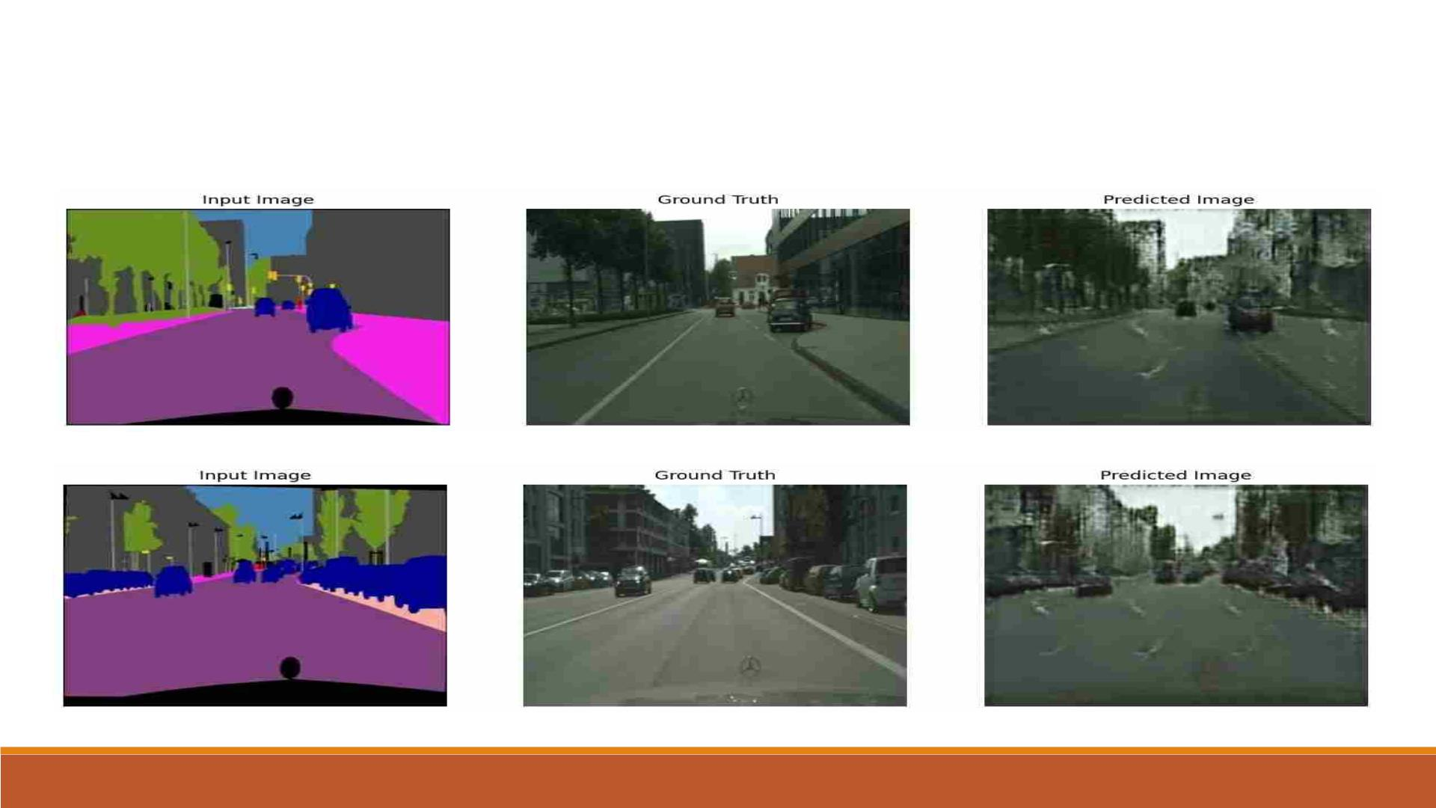
Pix2Pix: image translation with Conditional GAN
Generating some images using test data

Slide 28
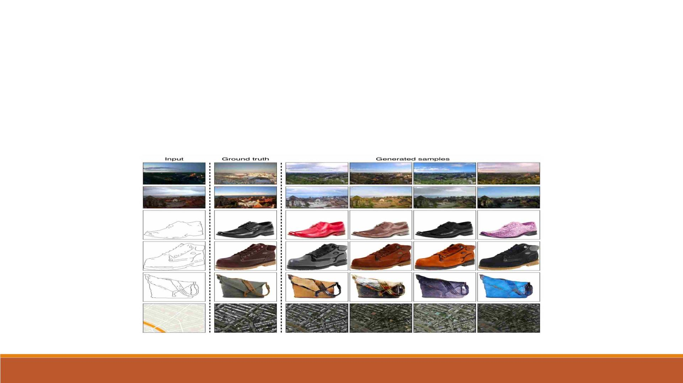
Pix2Pix: Image to Image translation Uses
Ø It can be applied to a wide range of tasks, including synthesizing photos from label
maps, generating colorized photos from black and white images, turning Google Maps
photos into aerial images, and even transforming sketches into photos.

Slide 29
